Slide 1
CIHR Townhall
January 2015
Dr. Jane E. Aubin
Canadian Institutes of Health Research

Slide 2
Objectives
The objectives of today’s presentation are to:
  Introduce CIHR’s new Strategic Plan – Health Research Roadmap II - Capturing innovation for better health and health care
  Address some of the rumours about CIHR’s budget and changes to the Institutes
  Provide an update on the first Foundation Scheme Pilot – including some of the preliminary survey results
  Provide an update on the launch of the Project Scheme and the College of Reviewers
2

Slide 3
Health Research Roadmap II - Capturing innovation for better health and health care

Slide 4

What is the link between Roadmap I and Roadmap II?
Health Research Roadmap II (2014) is an updated version of CIHR’s previous strategic plan (2009-2013).
It strikes a balance between completing the transformation we set to achieve in Roadmap (2009), and aligning to the future.
CIHR
HEALTH RESEARCH ROADMAP II:
Capturing innovation to produce better health and health care for Canadians
Strategic Plan 2014-15 – 2018-19
Completing Roadmap
Aligning to the Future
A number of current Roadmap initiatives and activities will continue to be an important part of Roadmap II.
There will also be new initiatives and activities that CIHR must embrace to stay relevant and aligned to the future.
4

Slide 5
What are CIHR’s strategic directions
for the next five years?
Roadmap II’s strategic directions will guide efforts and investments to advance knowledge and capture innovation for better health and health care.
Strategic Direction #1
Promoting excellence, creativity and breadth in health research and knowledge translation
Feeding the innovation pipeline
Re-defining excellence in training
Capturing innovation to produce better health & health care for Canadians
Supporting leading researchers and important advances in health
Building a solid foundation for the future
Strategic Direction #2
Mobilizing health research for transformation and impact
Identifying research gaps and prioritizing needs
Developing strategic initiatives
Increasing capacity and impact
Health Innovations
Aboriginal
Wellness
Prevention & Promotion
Quality
of Life
5

Slide 6

Does CIHR still value
Investigator-Initiated Research?
Strategic Direction #1
Promoting excellence, creativity and breadth in health research and knowledge translation
Supporting investigator-initiated ideas and research, from discovery to application.
Decreasing researcher burden with the implementation of the Foundation and Project Open funding schemes.
Improving the effectiveness, consistency, reliability, fairness and sustainability of peer review decisions through changes to peer review processes.
Ensuring the sustainability of the health research enterprise through the development of a national vision to position trainees for success in both academic and non-academic careers.
EXCELLENCE
CIHR is committed to supporting investigator-initiated research.
6

Slide 7

Why does CIHR invest in
Priority-Driven Research?
Strategic Direction #2
Mobilizing health research for transformation and impact
Maximizing the health, social and economic impact of research through targeted and partnered investments.
Enabling multidisciplinary research to address complex research questions.
Focusing critical health issues championed by Canadians.
Forging strategic alliances with new health and non-health partners.
MOBILIZE
Success in health innovation will be achieved through strategic alliances.
7

Slide 8
What are the new refreshed priorities for Priority-Driven Research?
Discussions with researchers, partners and other stakeholders have informed a refreshed set of priorities.
Enhanced patient experiences and outcomes through health innovation
Accelerating the discovery, development, evaluation and integration of health innovations into practice so that patients can receive the right treatments at the right time.
Health and wellness for Aboriginal peoples
Supporting the health and wellness goals of Aboriginal peoples through shared research leadership and the establishment of culturally-sensitive policies and interventions.
A healthier future through preventive action
A proactive approach to understanding and addressing the causes of ill health, and supporting physical and mental wellness at the individual, population and system levels.
Improved quality of life for persons living with chronic conditions
Understanding multiple, co-existing chronic conditions and supporting integrated solutions that enable Canadians to continue to participate actively in society.
8

Slide 9
CIHR’s Budget and Changes to the Institutes

Slide 10





Was CIHR’s budget cut by 50%?
CIHR Budget 2014-15 - $1,018.1M
Investigator Initiated Operating Support
Recent government investments have focused on Tri-Council programs for training and horizontal initiatives.
* Anticipated budget, including 2014-15 Supplementary Estimates C and adjustments to be provided by Treasury Board.
10

Slide 11
How much of CIHR’s budget is allocated to Investigator-Initiated Operating Grants?
In 2012, CIHR’s Governing Council committed to increasing the funding envelope for the Investigator-Initiated programs by $10M a year cumulatively for five years, beginning in 2014.
11

Slide 12
Will researchers be forced to find their own partners in order to access CIHR funding?
Researchers will not be forced to find their own partners for the Foundation Scheme, the Project Scheme, or for the awards programs.
Leverage is required for many priority-driven initiatives and this leverage will sometimes come from CIHR-Institute partners and sometimes from applicant partners.
12

Slide 13
Why is CIHR making changes to the Institutes?
Governing Council has now completed the Institutes Model Review as mandated in the CIHR Act, and as recommended by the 2011 International Review Panel.
This review has resulted in two key changes:
  Restructuring the Institute Advisory Boards (IABs) such that members will advise more than one Institute
  Enhancing effective cooperation with the Institutes by having them invest half of their budget into a Common Research Fund
These changes will:
      Provide Institutes with a broader, higher level strategic perspective
      De-silo Institutes and provide for greater inter-Institute collaboration and more cross-disciplinary research
      Promote linkages with national multi-disciplinary initiatives and platforms (e.g. NCEs, CECRs, Genome Centers, SPOR Support Units, etc.)
      Continue an evolution from a researcher-driven to an impact-driven agenda
13

Slide 14
When will the changes to the Institutes be implemented?
The changes to the Institute Advisory Boards will take time.
Work is currently underway with the chairs of the current boards to build the new model.
Once a new model has been identified, it will be communicated broadly.
Until that time, the existing advisory boards will remain in place.
The common fund, which is essentially a reallocation of resources to better support Signature Initiatives, will be established at the beginning of CIHR’s next fiscal year (April 1st, 2015).
14

Slide 15
Foundation Scheme Pilot

Slide 16
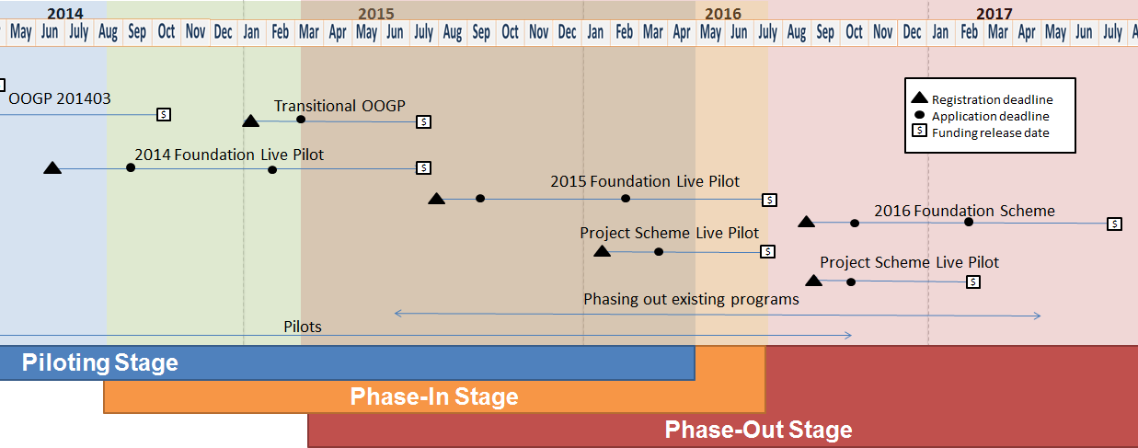
Where are we in the transition process?
The transition to the new Open Suite of Programs and peer review processes will occur over a number of years.
Course corrections and adjustments may be required along the way as we learn from the results of the pilots.
16

Slide 17
What changes were made as a result of earlier pilots?
Piloting is an essential part of the transition plan.
As each of the pilot studies is complete, findings are made available to contribute to the body of literature on peer review and program design.
  Fellowships – completed (www.cihr-irsc.gc.ca/e/47940.html)
  Knowledge Synthesis Pilot #1 – completed (report to be posted shortly); Pilot #2 – underway
  Partnerships for Health System Improvement (PHSI) – underway
  Knowledge to Action – underway
Improvements have already been implemented as a result of early pilot results:
  Development of a new rating scale for reviewers with more gradation at the higher levels.
  Establishment of a virtual chair/moderator role to shepherd sets of applications and ensure that online discussions are being held for applications with discrepant reviews.
  More comprehensive training material for applicants.
  More comprehensive training material for reviewers.
  Technology enhancements to ResearchNet to improve usability.
17

Slide 18
Are applicants and reviewers responding to the pilot surveys?
The response rates for the first Foundation Scheme pilot were exceptionally high
Response Rates for Foundation Scheme pilot Stage 1 (as of Jan 14, 2015)
Participant Role | Total # Invited (Survey) | Total # Responded | Survey Completion Rate
Applicant | 1366 | 1074 | 78.6%
Stage 1 Reviewer | 443 | 322 | 72.7%
Virtual Chair | 50 | 40 | 80%
Surveys just recently closed, and the data presented in the next few slides is preliminary.
The information presented in the following slides should therefore be interpreted with caution.
The full results of the pilots will be made available once the analysis is complete.
18

Slide 19
How many reviewers participated in
Stage 1 of the Foundation Scheme?
In Stage 1, 1366 applications were reviewed by 443 reviewers.
Each reviewer was assigned between 8-20 applications. The average was 15 applications. Almost all applications were reviewed by 5 reviewers.
As the tool to match reviewers to applications was not in place for this pilot, a labour intensive manual process was used for assignment.
For future pilots, a matching solution will be put in place.
This will assist CIHR staff and the virtual chairs/moderators with the assignment of reviewers to applications using “concept matching” functionality.
19

Slide 20
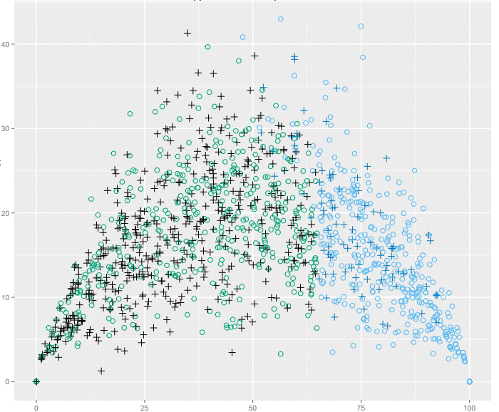
Who was successful in Stage 1 of the Foundation Scheme?
After analyzing the results of the competition and the available budget, CIHR has invited 467 (34%) applicants to submit a Stage 2 application.
At this point in the process, it is anticipated that between 150-210 applications will be funded in the first pilot.
Total Distribution of Applications
Standard Deviation
Consolidated Ranking
Invited to Stage 2
+
New Investigator – Invited to Stage 2
20
Not Invited to Stage 2
+
New Investigator – Not Invited to Stage 2

Slide 21
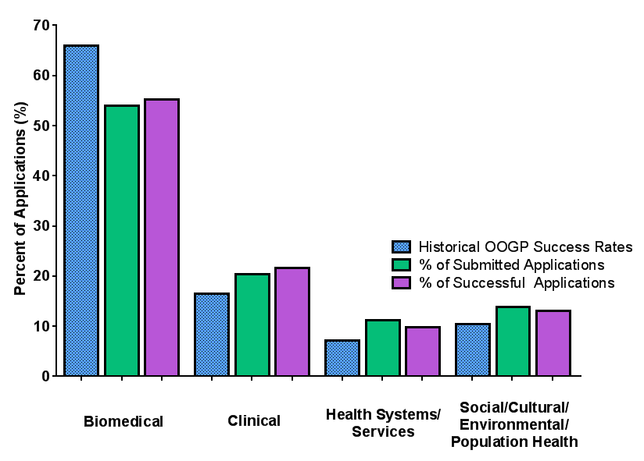
What was the pillar distribution for
Stage 1 of the Foundation Scheme?
Distribution of Applications by Pillar
Distribution of Applications by Pillar
Percent of Applications (%)
Historical OOGP Data (% of Successful Applications)
% of Submitted Applications
% of Successful Applications
Biomedical
Clinical
Health Systems/ Services
Social/Cultural/ Environmental/
Population Health
21

Slide 22
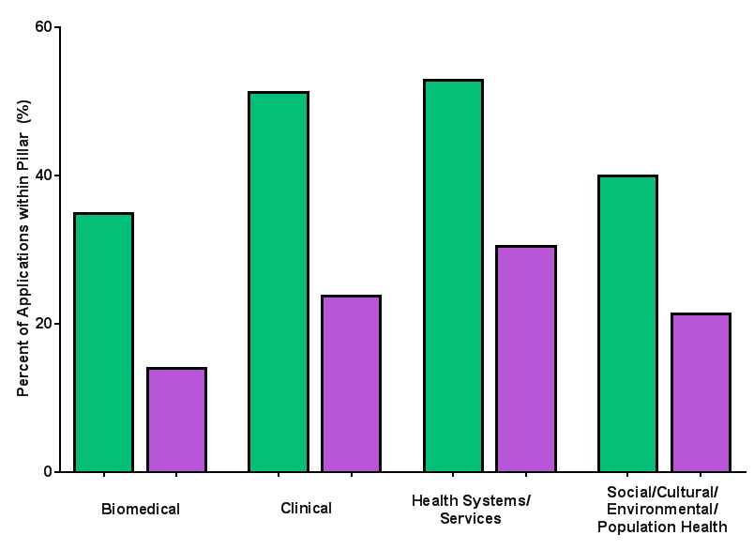

How did new/early career investigators do in Stage 1 of the Foundation Scheme?
The first Foundation Scheme competition received more applications from new/early career investigators than originally expected (40.92% of applications).
Peer reviewers expressed some concern about their ability to rank very new investigators.
Despite these challenges, almost 20% of all applications (87 of the 467) that were brought forward to Stage 2 were submitted by new/early career investigators.
This is comparable to what is typically seen in the OOGP (~15%).
CIHR has committed to ensuring that a minimum of 15% of the funded Foundation grants at the end of the process will be awarded to new/early career investigators.
Distribution of Applications submitted by New/Early Career Investigators by Pillar
% Submitted
% Successful
Percent of Applications within Pillar (%)
Biomedical
Clinical
Health Systems/ Services
Social/Cultural/ Environmental/
Population Health
22

Slide 23
How did mid-career investigators do in
Stage 1 of the Foundation Scheme?
CIHR does not currently have a definition for “mid-career investigator”.
The system does track:
  Applicants who have been independent researchers for 5 – 10 years (61 – 120 months)
  Applicants who indicated their current academic position to be “Associate Professor”
Distribution of Applications Submitted
% Submitted
% Successful
Percent of Total Applications (%)
34%
32%
27%
Overall Applications
5-10 years as
Independent Researcher
Associate Professor
* There is overlap between the individuals included in the “5 -10 years as an Independent Investigator” and the “Associate Professor” categories in the figure above.
23

Slide 24
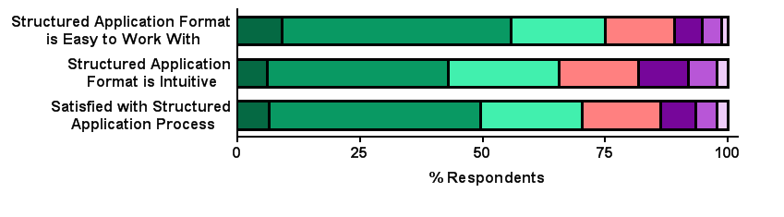
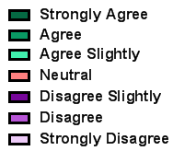
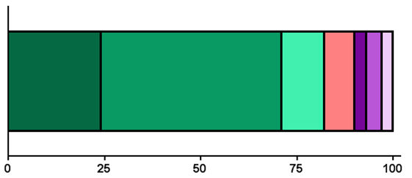
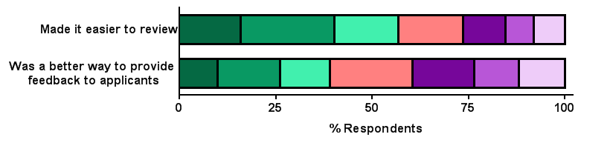
Is the structured application/review working?
Applicants
* The data presented is preliminary data gathered from survey respondents who participated in Stage 1 of the first Foundation Scheme live pilot, and further analysis is required.
Thoughts regarding the structured application format (i.e. having one section for each adjudication criterion)
The Structured Application
Format is Easy to Work With
The Structured Application
Format is Intuitive
Applicants are Satisfied with the Structured Application Process
% Respondents
Reviewers
The structured application format was helpful in my review process
% Respondents
Compared to the last time reviewers reviewed applications for CIHR (i.e. completed a non-structured review), completing a structured review:
Made it Easier to Review
Was a Better way to Provide Feedback to Applicants
24
% Respondents

Slide 25
Are reviewers able to assess the criteria across all career stages?
Reviewers were provided with interpretation guidelines for each of the adjudication criteria and then asked to apply these based on career stage (www.cihr-irsc.gc.ca/e/48193.html):
  Leadership
  Significance of Contributions
  Productivity
  Vision/Program Direction
Feedback from reviewers has indicated that it was difficult to apply the adjudication criteria across career stages.
  Reviewers found the Leadership criterion to be particularly difficult to apply.
CIHR will look at providing additional guidance to reviewers in the next pilot.
25

Slide 26
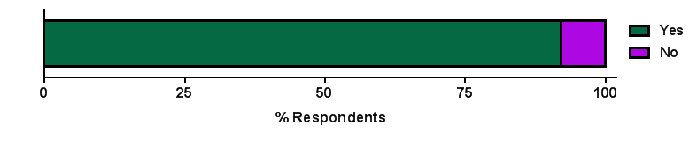
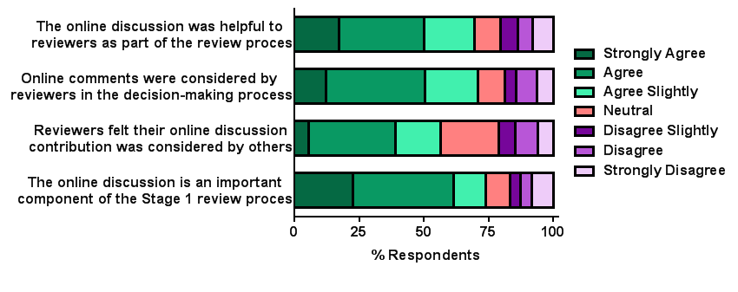
Are reviewers participating in online discussions?
* The data presented is preliminary data gathered from survey respondents who participated in Stage 1 of the first Foundation Scheme live pilot, and further analysis is required.
Did reviewers participate in online discussions?
Reviewer thoughts regarding the online discussion:
26

Slide 27
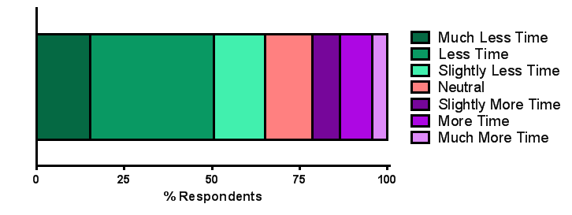
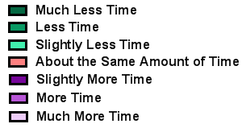
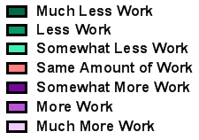
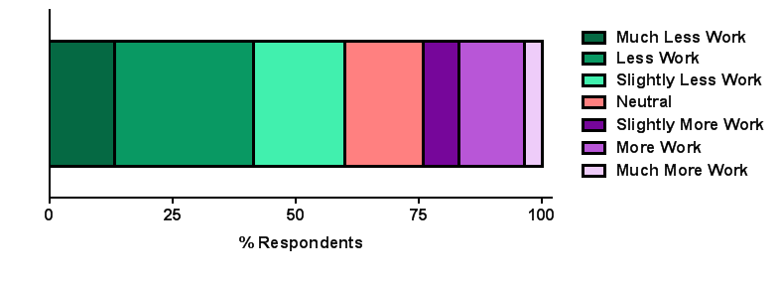
Is applicant and reviewer burden starting to decrease?
* The data presented is preliminary data gathered from survey respondents who participated in Stage 1 of the first Foundation Scheme live pilot, and further analysis is required.
Applicants:
Compared to the last time you submitted an application to CIHR, completing the structured application took, on average:
Reviewers:
Compared to the last time you reviewed for a CIHR competition, the workload assigned to you was:
27

Slide 28
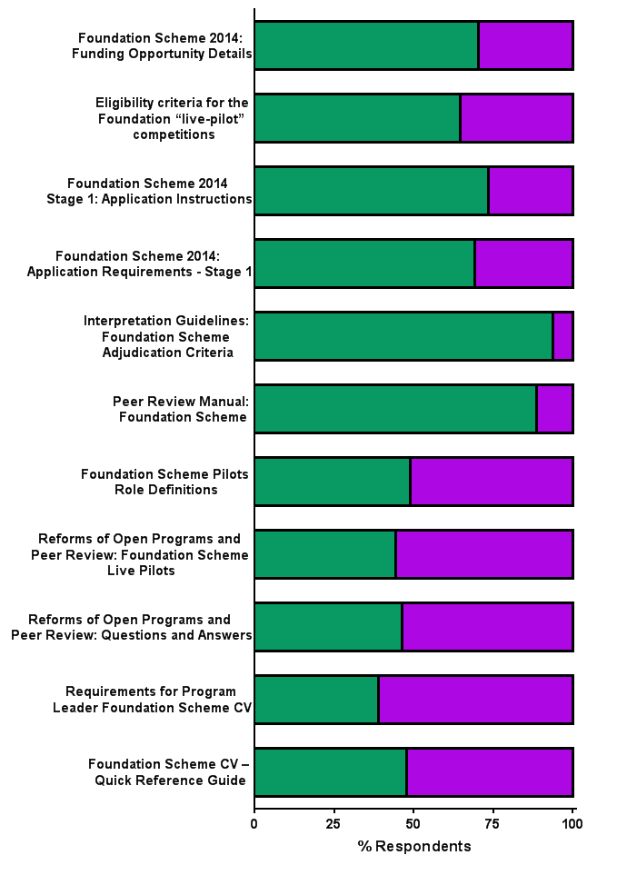
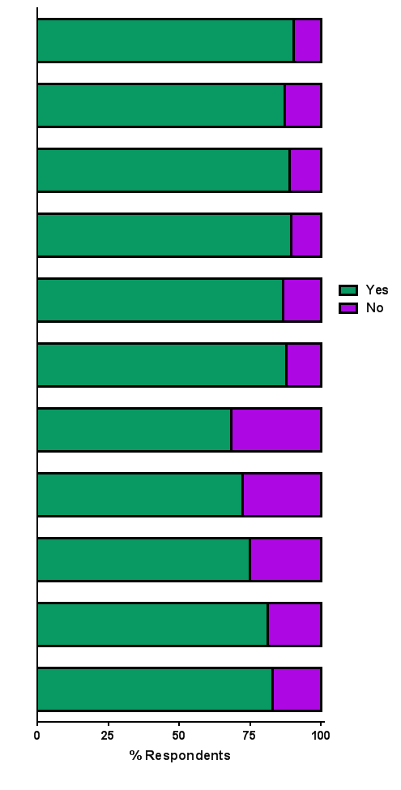
Is the support material for reviewers effective?
Reviewers
* The data presented is preliminary data gathered from survey respondents who participated in Stage 1 of the first Foundation Scheme live pilot, and further analysis is required.
Documents were used
Documents were useful
28

Slide 29
I am preparing my Stage 2 application, what should I consider in my budget request?
You are required to establish a budget baseline based on your funding history. This information will be considered as part of the evaluation of your Foundation Scheme budget request.
If your budget request exceeds the baseline amount, a justification for the additional amount requested must be provided. This will be assessed by peer reviewers.
To establish this baseline:
  Provide an overview of your past relevant funding history from CIHR (applicants currently holding CIHR funding); or,
  Provide an overview of other funding that you currently hold (or have held) in the past 7 years (applicants who have never held CIHR funding).
Ultimately, the onus is on the applicant to justify to their peers that the amount they are requesting is appropriate to support their proposed program.
For complete budget instructions, please refer to the Stage 2 Application Instructions available on the CIHR website (http://www.cihr-irsc.gc.ca/e/48824.html).
29

Slide 30
When will funding decisions be made for the 2014 Foundation Scheme?
Decisions for the first Foundation pilot will occur in July 2015.
The competition timelines for the 2014 Foundation Scheme "live pilot" are as follows:
Registration Deadline | June 23, 2014
Stage 1 Application Deadline | September 15, 2014
Anticipated Stage 1 Notice of Decision | December 1, 2014
Stage 2 Application Deadline | February 5, 2015
Anticipated Stage 2 Notice of Decision | May 15, 2015
Anticipated Stage 3 Notice of Decision | July 15, 2015
Funding Start Date | July 1, 2015
30

Slide 31
How will the budget be shared between Foundation Scheme and the Transitional OOGP?
The combined budget available for the Transitional OOGP and the 2014 Foundation Scheme "Live Pilot" is approximately $500M.
The exact allocation of funds between the two programs will be determined based on application pressure and requested budgets.
CIHR estimates that it will fund approximately 450-600 Transitional OOGP grants and between 150-210 Foundation grants.
Approximately 3330 applicants have registered for the Transitional OOGP competition
The previous OOGP competition received 3270 registrations.
31

Slide 32
Project Scheme

Slide 33
When is the Project Scheme being launched?
The funding opportunity for the 2016 Project Scheme “live pilot” competition will be posted before March 2015 to provide the community with time to prepare.
Key dates include:
Registration Deadline | January 15, 2016
Stage 1 Application Deadline | March 1, 2016
Anticipated Stage 1 Notice of Decision | May 16, 2016
Anticipated Notice of Decision | July 4, 2016
Funding Start Date | July 1, 2016
The Project Scheme is designed to capture ideas with the greatest potential for important advances.
33

Slide 34
What is the plan for integrating existing legacy open programs?
As part of the implementation of the Reforms, a number of existing open programs will be integrated.
CIHR has been piloting the new Project Scheme design elements in many of these programs to ensure applicability of the new design.
As the pilot results have been positive, these programs will be integrated into the new open funding schemes. The application deadlines for the final competition for each of these programs are:
To ensure a smooth transition, minimum thresholds will be established for partnered/integrated KT applications in the Project Scheme and for new/early career investigators in the Foundation Scheme.
Legacy Open Program | Competition Launch | Application Deadline
Open Operating Grants Program | November 2013 | March 2015
Partnerships for Health System Improvement | June 2015 | October 2015
Knowledge Synthesis | June 2015 | December 2015
Knowledge to Action | June 2015 | October 2015
Proof-of-Principle (I and II) | June 2015 | September 2015
Industry-Partnered Collaborative Research Program | June 2015 | September 2015
New Investigator Salary Awards | July 2015 | December 2015
34

Slide 35
College of Reviewers

Slide 36
When will recruitment for the College begin?
CIHR will begin to enroll College members in the coming months, using a phased-in approach.
The first waves will be CIHR’s current and recently active reviewers.
Reviewers will be asked to agree to a set of terms and conditions for the College and will be asked to validate a reviewer profile.
In parallel, a number of targeted recruitment approaches will be developed to address areas where there are gaps in reviewer expertise.
If you are interesting in becoming a member of the College of Reviewers please contact the research office at your institution.
CIHR will be coordinating with institutions to identify potential College members.
Quality Peer Review
and Peer Review System
Breadth and Diversity of Experience
Structured
Recruitment
Training
and
Mentoring
Quality
Assurance
Recognition
Program
36

Slide 37
Who is helping CIHR build the College?
An Interim Advisory Group has been established to:
  Serve as an advisory body to refine the College design
  Act as champions for the College and its credibility
  Contribute to defining the structure for the College of Reviewers
  Provide input and advice into the key components, as well as short-term targets of the College
College Advisory Group Members:
Gerry Wright, McMaster University (Chair)
Brett Finlay, University of British Columbia (previous Chair – on sabbatical)
Ivy Bourgeault, University of Ottawa
Andreas Laupacis, St. Michael’s Hospital
Martin Schechter, University of British Columbia
Senior leaders will also be recruited from various research communities to act as expertise cluster leads in the College. An expression of interest process will be launched in February 2015.
Key partners are also being engaged as we develop key elements of the College.
37

Slide 38


